Slide 1
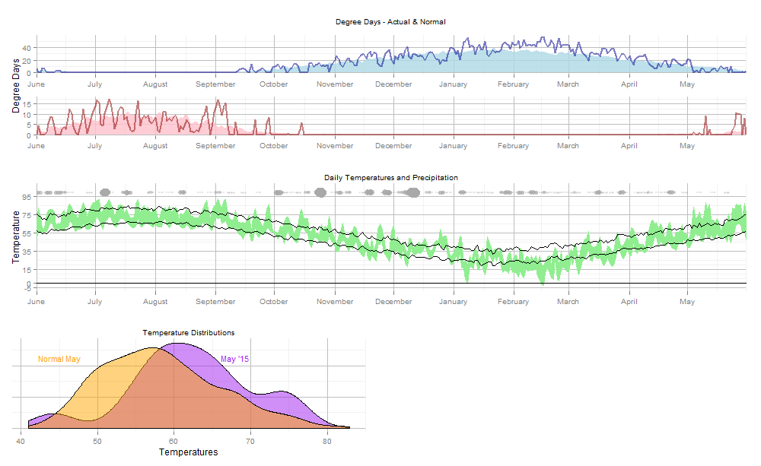

Boston Weather Last 12 Months
Actual
HDD - 65
Normal
CDD - 65
Temperature Data for May 2015 vs. Normal
Legend
May Data | Normal | 2015
Mean Temp | 58.2 | 62.2
Median Temp | 57.5 | 62.5
Min / Max Temp | 46.2 / 74.4 | 44 / 75.5
HDD’s / CDD’s | 253 / 28 | 156 / 52
Actual High / Low Temp
Normal High
Low
Lots of Precipitation
Not Much Precipitation

